Slide 1

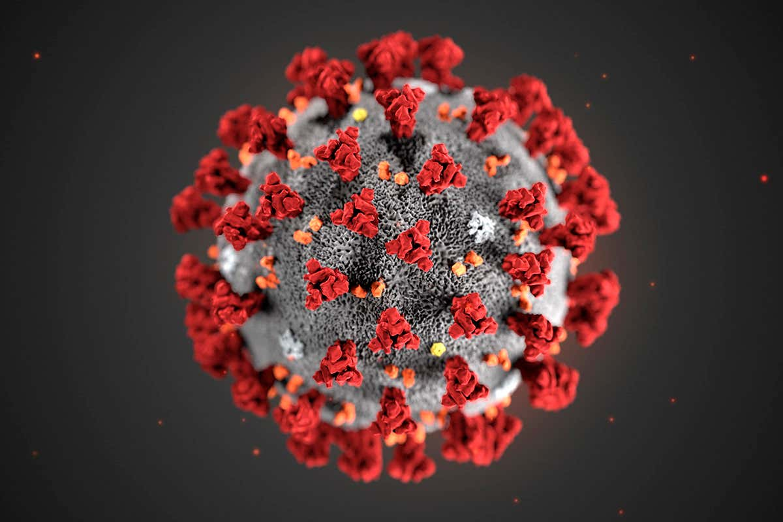
Team 9 - Karen Sparck-Jones creatING a standardized index to categorize the risk level of covid-19 spread in communities
Mission: Predictable A Virtual Machine Learning Hackathon to Battle Covid-19
Team Members:
Amy Jacobs, Web architect (Alaska)
Funke Olaleye, Data Analyst (New Jersey)
Hani Patel, Data Analyst (Washington)
Elizabeth Qiu, High School student (Maryland)

Slide 2
Problem Statement
The COVID-19 pandemic has led to a worldwide shutdown of a major part of our economic and social activities due to the restrictions.
More than half of the nation’s population lives in areas that are less prepared than New York City, where in early April of 2020, officials scrambled to add more ICU beds and find extra ventilators amid a surge of COVID-19 patients.
With respect to reopening the economy, governmental response and messaging have been inconsistent, and policies have varied by state.
As states struggle to contain the outbreak and at the same time face great pressure in resuming economic activity, an index that provides a data-driven and objective insight is urgently needed. A lack of objective criteria and monitoring towards satisfying the criteria can lead to another COVID-19 outbreak and business closures.

Slide 3
Standardized Index
Our solution creates a standardized index to categorize the risk level of COVID-19 spread in communities based on the paper A COVID-19 Reopening Readiness Index: The Key to Opening up the Economy. The index is based on five broad categories: COVID-19 cases, infection rate, hospitalization, testing and mortality.
It would help decision makers (for example, hospitals) to adequately prepare for and respond to a surge in cases by projecting and planning for additional peak needs and peak capacity for bed use, ICU use and ventilators. Particularly in rural American areas in Alaska, where Amy, one of our teammates lives that continues to face significant resource needs and capacity.

Slide 4
DaTasets
Source of the datasets are from:
John Hopkins University, School of Engineering Novel Coronavirus (COVID-19) Cases, provided by JHU CSSE URL: CSSEGISandData
The COVID Tracking Project URL: US State data
AWS Data Exchange
URL: USA Hospital Beds - COVID-19 | Definitive Healthcare
Provided By: Rearc
Definitive Healthcare provides intelligence on the numbers of licensed beds, staffed beds, ICU beds, and the bed utilization rate for the hospitals in the United States

Slide 5
DATA challenges
Our goal is to implement a composite index at the city level. IHME dataset on AWS data exchange could have been an ideal dataset to use for this project but most of the observations have null values at the city level.
We decided to go with a state level approach to create a standardized index to categorize the risk level of COVID-19 which can be applied to any city level in the future.
The Covid tracking dataset contain some deprecated variables and lacks the hospital and ICU beds details.
The US Hospital beds dataset, however, contains some valuable licensed, staffed beds, ICU beds details.
We combined 2 datasets, the COVID-tracking dataset and the US Hospital beds to form a viable dataset for this project. We created a standardized index based on the paper.

Slide 6
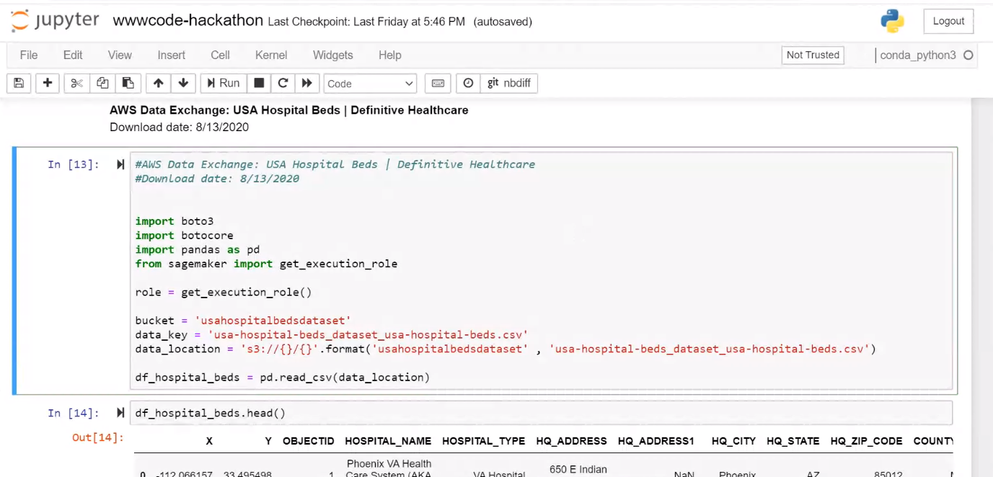
DaTa model AND AWS Products
We generate our model using Amazon SageMaker and linear regression model.
AWS Products: We have used below AWS products to develop our solution.
AWS Data Exchange
AWS Sagemaker
AWS S3
Solutions:
Link to Jupyter Notebook on Github
Link to Sagemaker Solution

Slide 7
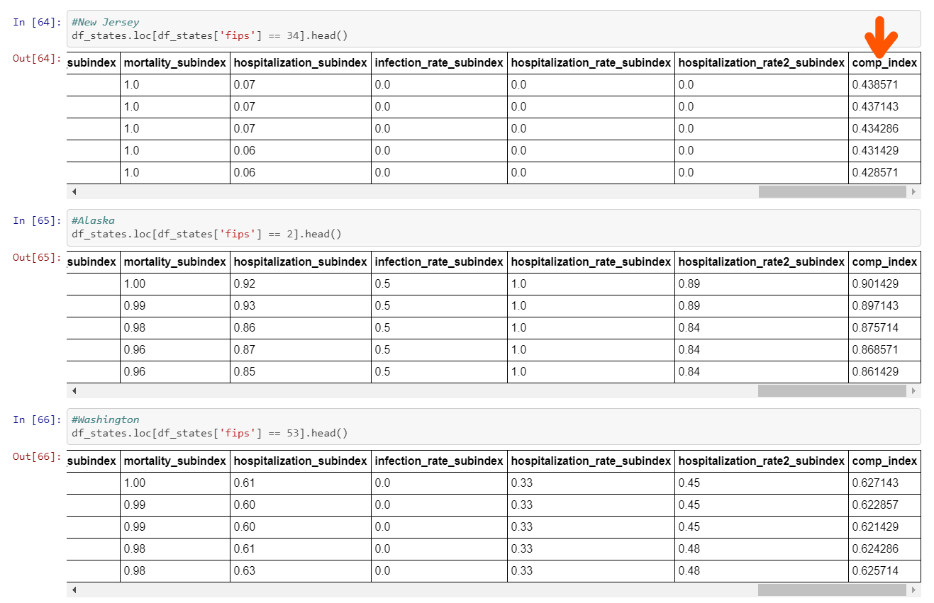
Results
From the model, we discovered the daily composite index using 5 different indicators.
According to the model, we can make different calculated predictions. For example, New Jersey is more prepared to re-open than Alaska.

Slide 8
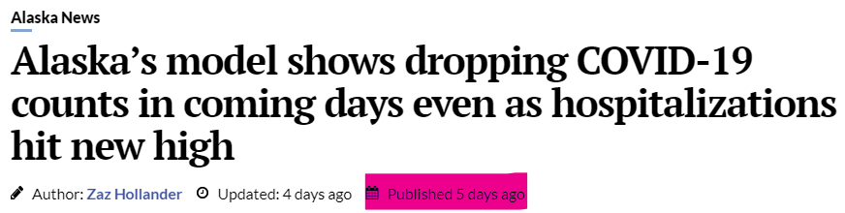
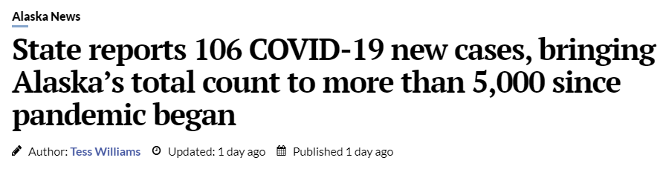
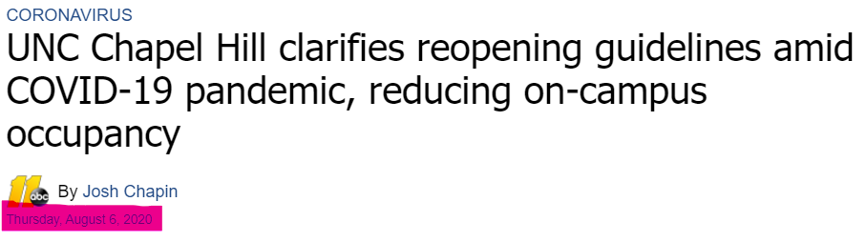
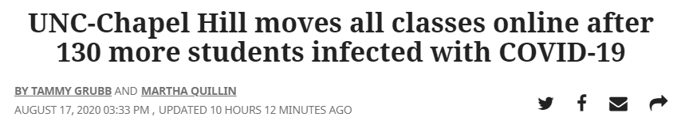
Potential Benefits of model: Comparisons
8/13/20: Cases were dropping in Alaska https://www.adn.com/alaska-news/2020/08/13/alaskas-model-shows-dropping-covid-19-counts-in-coming-days-even-as-hospitalizations-hit-new-high/
8/16/20: Cases rose again in Alaska https://www.adn.com/alaska-news/2020/08/16/state-reports-106-covid-19-new-cases-bringing-alaskas-total-count-to-more-than-5000-since-pandemic-began/
8/6/20: Despite a high index in NC (0.89), UNC Chapel Hill decides to have in-person classes https://abc11.com/unc-covid-19-orange-county-health-department-quintana-stewart/6355557/
8/17/20: After 130+ students become infected within the first week of classes, UNC goes entirely virtual https://www.newsobserver.com/news/local/education/article245014185.html

Slide 9
Further Actions
Extend model to analyze data from the county/zip-code level
Categorizing findings based on demographics (e.g. age, ethnicity) → healthcare providers may also benefit from this data
Compare with different linear ML models
Evaluating Model:
Train/Test split
Cross validation
Shuffle training data
Features engineering

Slide 10

Highlight of Social Impact
The standardized index can help hospitals predict the amount of patients, and help them prepare the number of hospital beds needed.
Healthcare providers will be able to use this to predict future needs and take early action to prepare healthcare services.
State/local governments will be able to make informed decisions to enforce public health policies.

